Slide 1


PORTFOLIO
pramoddk2503@gmail.com

Slide 2
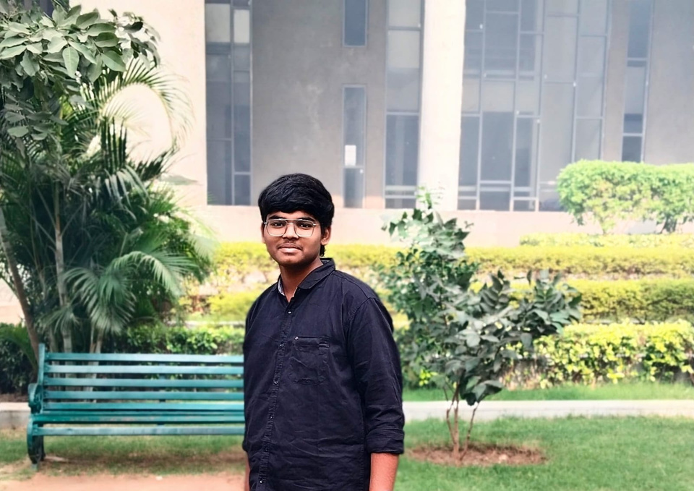
ABOUT ME
Pramodd Komarneni
I have a strong background in AI and Machine Learning, including key concepts like Supervised and Unsupervised Learning, Neural Networks, Clustering, and Regression. . Additionally, I know how to use Docker and Kubernetes to efficiently deploy AI models at scale. I'm also proficient in Python, Java, and Data Structures & Algorithms, and enjoy working on innovative projects in a team environment.

Slide 3

EDUCATION
Chandigarh University :- Bachelor of Engineering in Computer Science with IBM specialization in AIML, May 2026
Cumulative GPA: 8.04
Narayana Junior College :- Intermediate
Precentage:- 98.1

Slide 4
SKILLS
Programming Languages: Python, Java, C++, C, C#, JavaScript, Scala, Ruby, Go, AngularJS.
AI/ML & Data Science: Deep Learning, Machine Learning, Neural Networks, Reinforcement Learning, LLMs, Fine Tuning, GBDT, NLP, Soft Computing, Image Processing, Supervised & Unsupervised Learning, Classification, Regression, Clustering, AI Libraries (TensorFlow, PyTorch), Data Manipulation (pandas, NumPy), Foundation Models, Statistics, Linear Algebra, Probability, Data Manipulation and Analysis for large datasets, Model Validation.
Cloud & DevOps:
AWS, Azure, Docker, Kubernetes, Openshift, CI/CD, Data Engineering.
Software Development: Object-Oriented Programming (OOP), Data Structures & Algorithms, Dynamic Programming, Software Design, SQL, NoSQL, RDBMS, SDLC, Testing, HTML, HTTP, Unix, Windows.

Slide 5
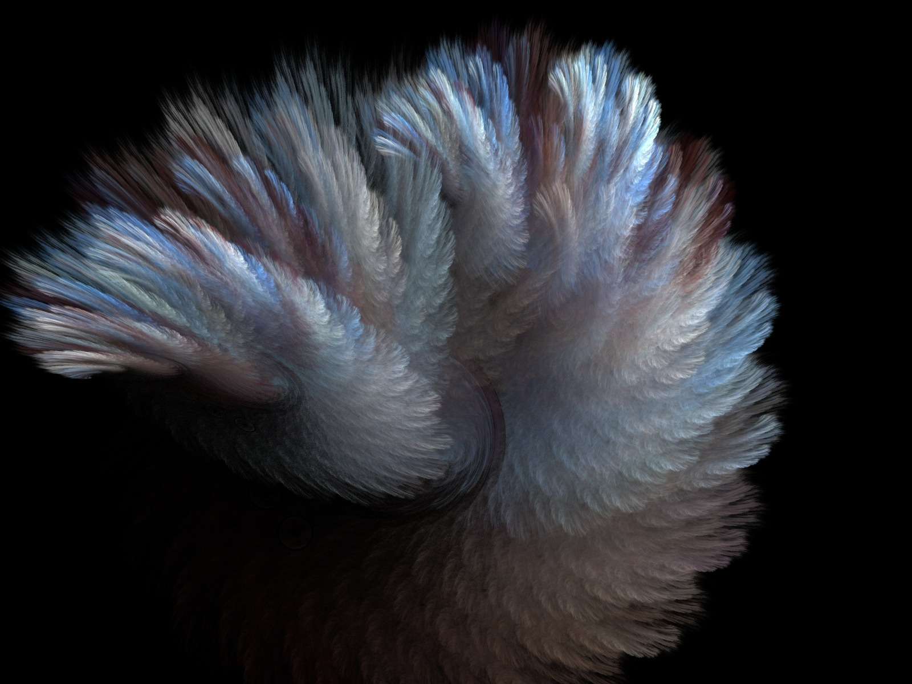
PROJECT 1
Optimizing Doctor Availability and Appointment Allocation Using Digital Technology to Reduce Patient No-Shows:-
ABOUT
Optimized Scheduling: Proposed a digital solution to optimize doctor availability and improve appointment allocation, reducing patient no-shows , manage time for both patients and doctors and enhancing clinic efficiency.
Automated Reminders: Integrated automated appointment reminders via SMS, email, or mobile app to minimize missed appointments.
Data-Driven Predictions: Utilized machine learning and predictive analytics to identify no-show patterns, enabling strategies like overbooking and targeted reminders.

Slide 6

EXPERIENCE I
Intern at Infosys
ABOUT
Gaining hands-on experience in a structured corporate environment, learning professional workflows and effective workload management.
Enhancing skills in time management, problem-solving, and teamwork by balancing challenging and manageable tasks to meet deadlines efficiently.
Acquiring industry-relevant insights and confidence, preparing for future professional roles with a focus on corporate readiness and career growth.

Slide 7

EXPERIENCE II
SmartBridge:
Generative AI Intern
Currently developing and fine-tuning Generative AI models using Google Cloud's AI/ML platforms, including Vertex AI.
Assisting in deploying and optimizing AI solutions for internal projects, with a focus on performance and scalability.
Gaining hands-on experience with Google Cloud Generative AI tools, working on text-to-image generation and LLMs.
Collaborating with senior engineers to apply state-of-the-art AI technologies in real-world scenarios.
Contributing to documentation and knowledge sharing on best practices for AI/ML in Google Cloud

Slide 8
LET’S WORK TOGETHER
EMAIL
PHONE
pramoddk2503@gmail.com
+91-8121327618
ADDRESS
Opp sports complex, chandigarh universuty

Slide 9
THANK YOU

